Slide 1
DS 200 Lab1 CoLab Jupyter Notebook and Introduction to Table
August 27, 2020
Fall 2020
Instructor: Prof. John Yen
TA: Rupesh Prajapati
LA: Nathan Joel Tack

Slide 2
Today’s Goals
Activate your PSU account on Google G suite
Learn to access Google Colab in G suite
Upload a Jupyter Notebook to Colab
Upload data files to Google Drive (of your PSU account)
Execute a Jupyter Notebook involving DataScience module
Be able to Edit the Markdown cell and code cell of your Notebook
Be able to use Table to read, display, and sort a CSV file of structured data.

Slide 3
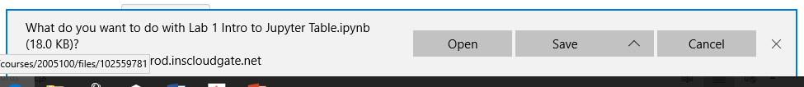
Downloand three files from Canvas
Go to Module 1 section of the Canvas class page
Download “Lab_1_Intro_to_Jupyter_Table.ipynb”
Click on “Lab_1_Intro_to_Jupyter_Table.ipynb”
Click on “Download Lab_1_Intro_to_Jupyter_Table.ipynb”
Click on the ^ next to Save, choose “Save as”
Select the folder on your computer you want to download the file to (may want to create a new folder called DS 200, and save the file in the folder)
Download “SFSalaries2011_2014.csv” and “IMDB5000movies.csv” following the same steps above.

Slide 4
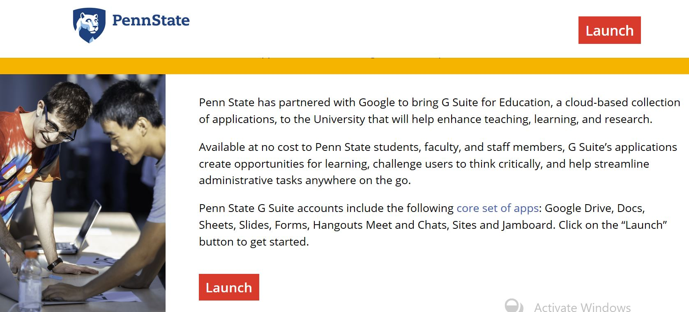
1. Activate your PSU account on Google G suite
Go to https://gsuite.psu.edu
Click on the Launch button

Slide 5
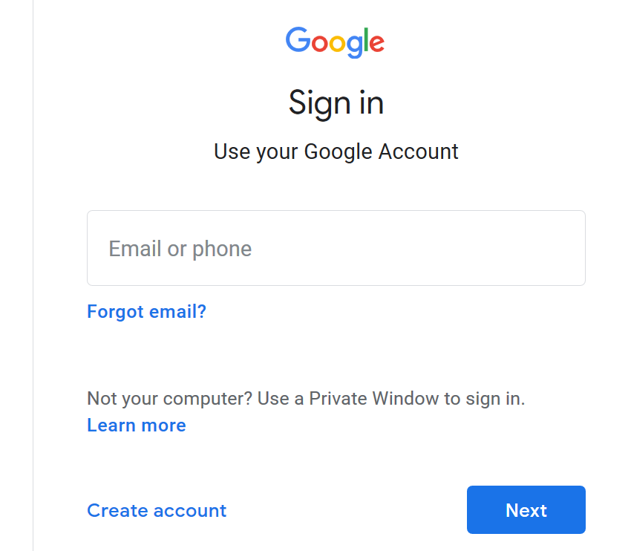
Sign in G Suite using your PSU Email (NOT your gmail)
You need to first create a PSU Google account (even if you already have gmail account) if you have not done so.
After you create the PSU account, you can sign in using your PSU email from this page.

Slide 6
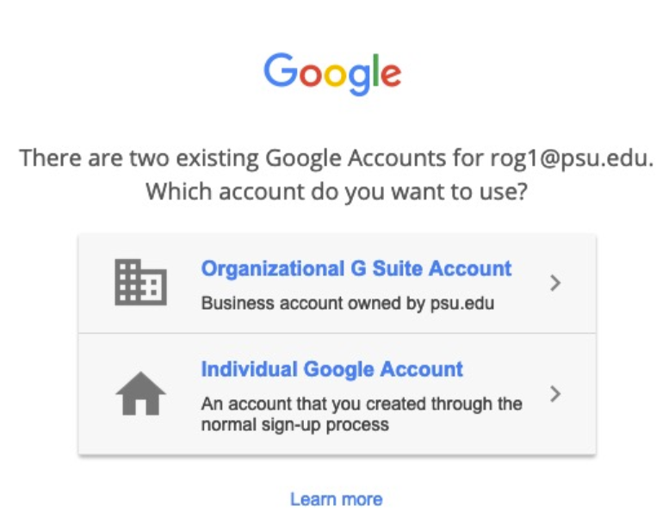
If you see this page, choose “Organizational G Suite Account”

Slide 7
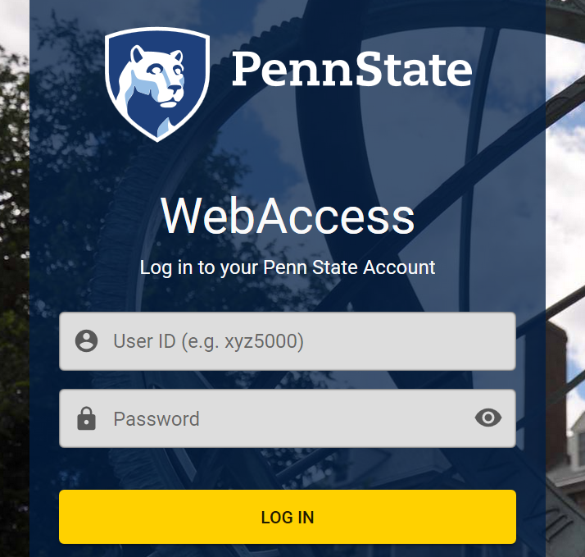
Penn State login window should appear, Log in as usual.

Slide 8
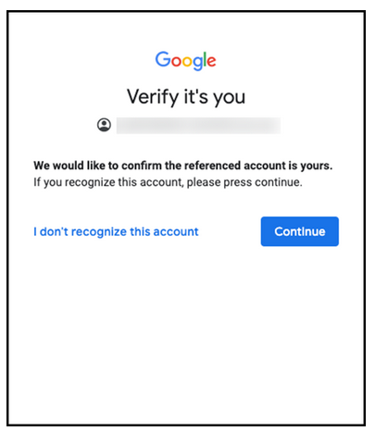
Verifying your PSU account for G suite
You may be asked to verify yourself during the process to create your PSU account for accessing G suite.
You verify the PSU e-mail address by clicking the “Continue” button.

Slide 9
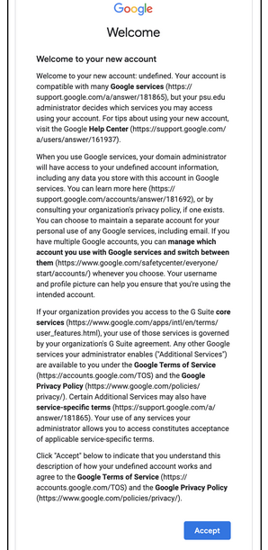
Accept Google Terms of Service
Click the Accept button.
You only need to do this once when you create the account.

Slide 10
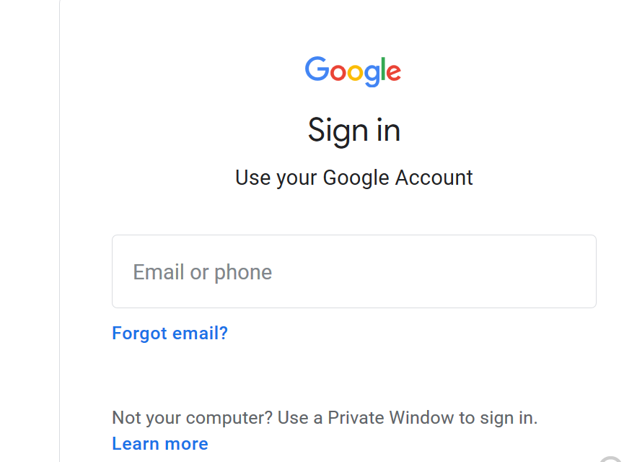
2. Learn to access Google Colab in G suite

Slide 11
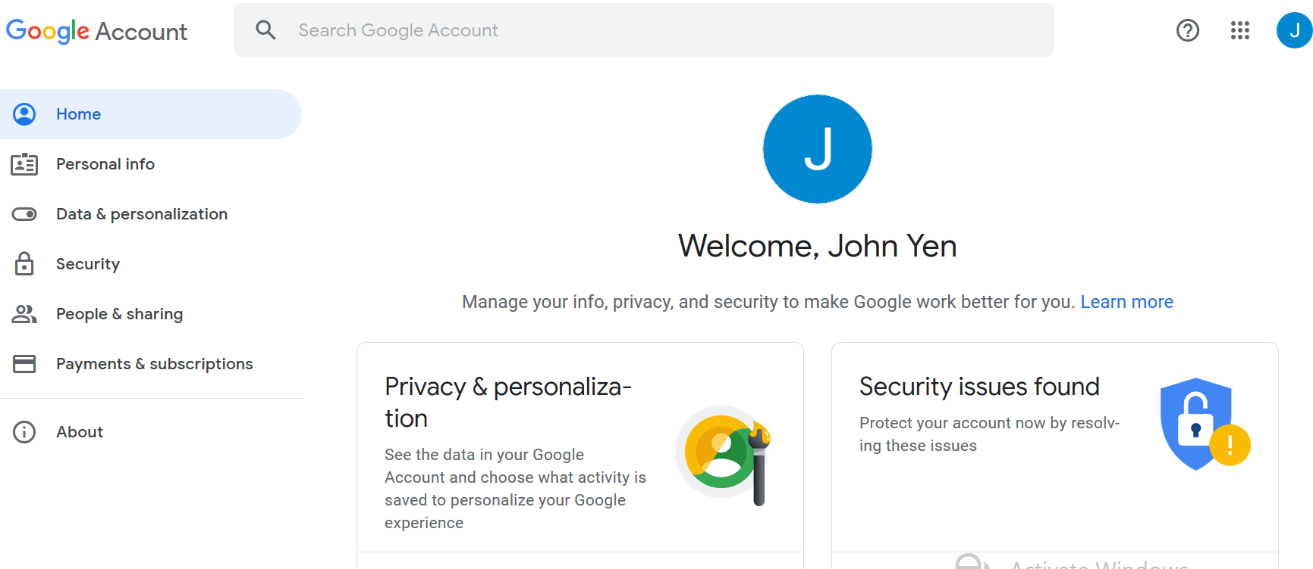
You will see the Home Page of Gsuite after you sign in using PSU account
Click on Google Apps on the upper right corner.
Scroll down to the bottom, select “More from G Suite Marketplace”.

Slide 12
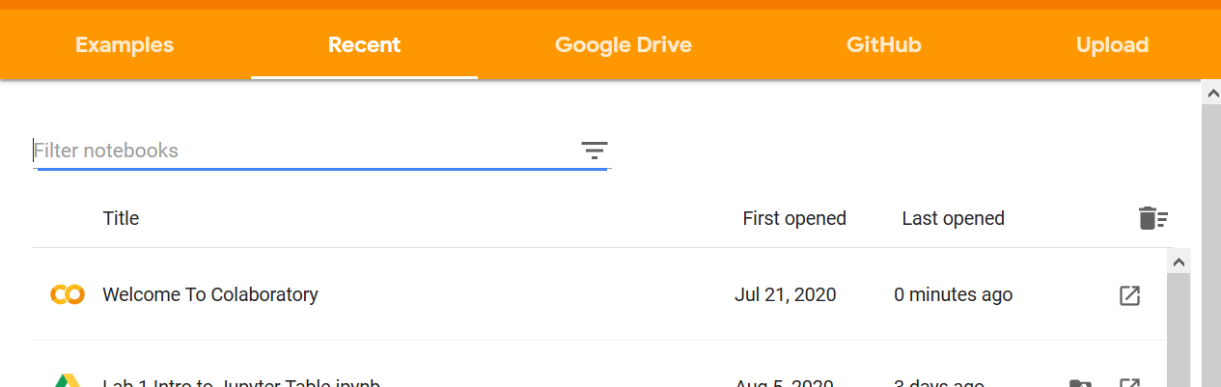
Accessing Google Colaboratory (Colab)
Visit https://colab.research.google.com
You will see the following pop-up window, with a Colab Notebook named “Welcome To Colaboratory”, click on it.
In the future, after you create or upload Jupyter Notebooks into Colab, you will see them here so that you can choose the one Notebook you want to work on.

Slide 13
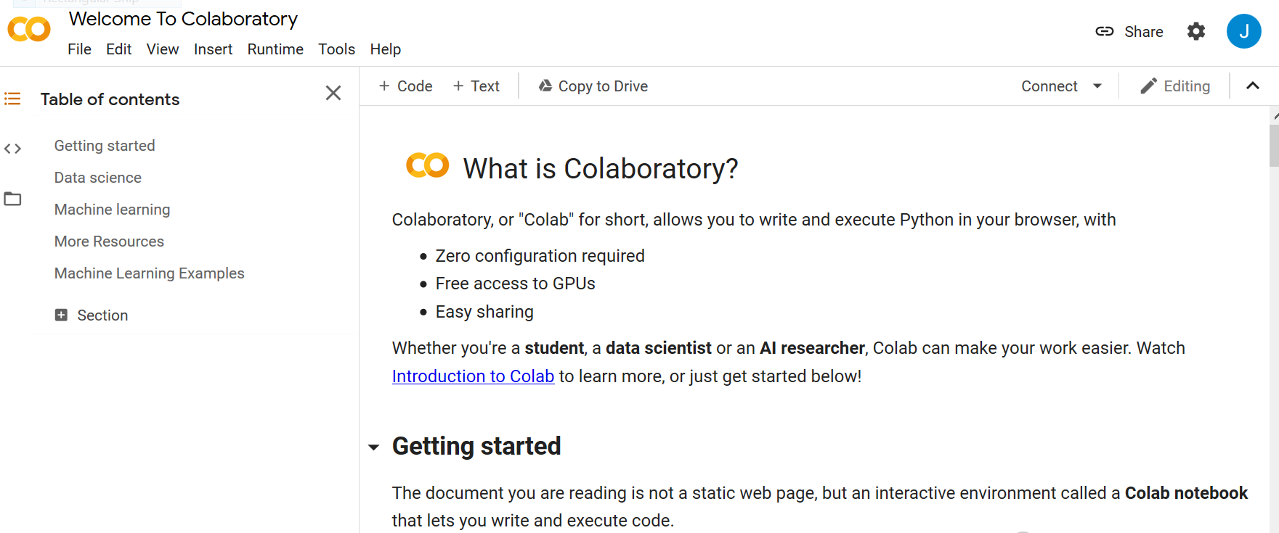
The “Welcome To Colab” Notebook
In all Colab Notebooks, you should see an icon indicating your name on the upper right corner.
On upper left, you will also see the top-level menus such as “File”, “Edit”, “Runtime”, etc.
On the left panel, you see “Table of contents” of the notebook, indicating major sections of the notebook.

Slide 14
What is a Jupyter/Colab Notebook?
Python Code
Cell
Markdown (HTML-like)
Text
Cell
Run
Edit
Results Displayed in the Notebook
Formatted Text
Displayed in the Notebook

Slide 15
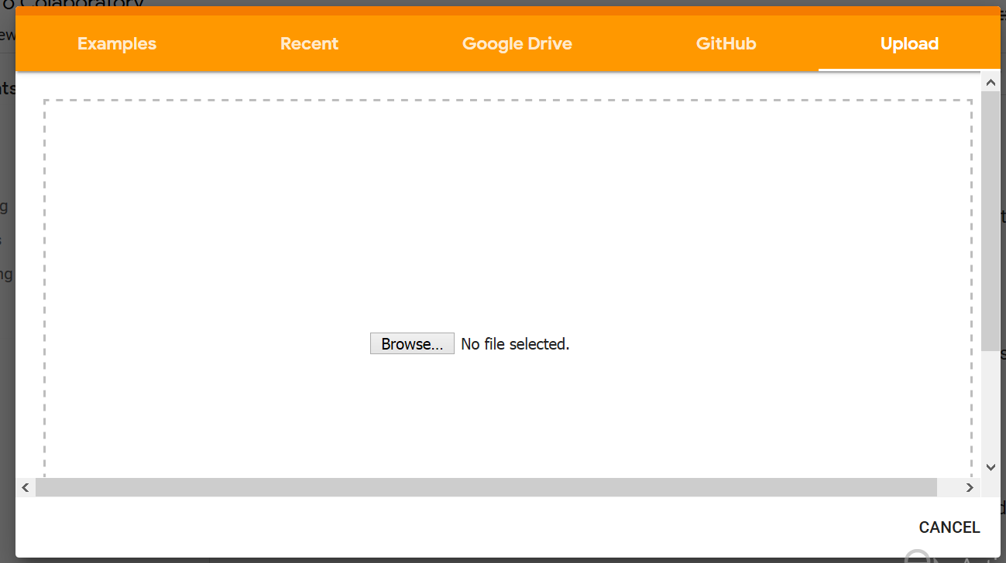
3. Upload a Jupyter Notebook to Colab
Click on “File” on the upper-left corner of the Colab window, select “Upload Notebook”
A pop-up window for uploading a file from your local computer/laptop will appear.
Click “Browse” to find the file from your local computer/laptop.
Select Lab 1 notebook you downloaded from Canvas.

Slide 16
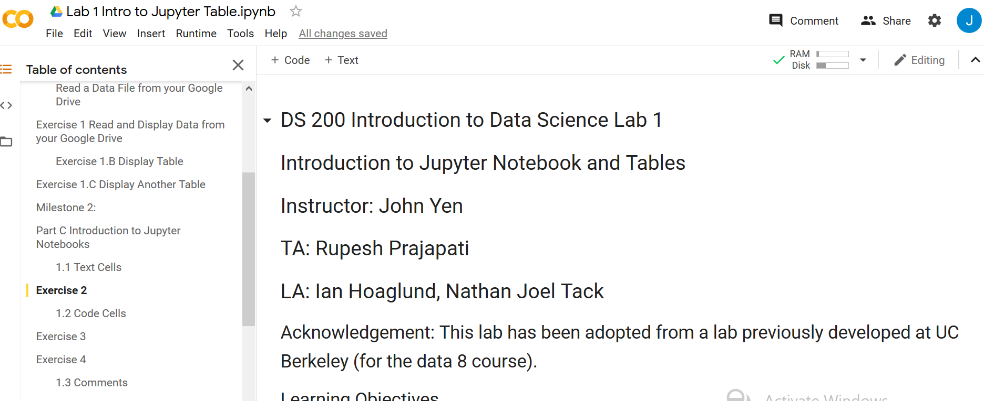
You will see the Lab 1 Jupyter Notebook in Codlab
Before you start working on the lab by following instructions on the Notebook, you need to upload two data files needed for the lab to your Google Drive (see next slide).

Slide 17
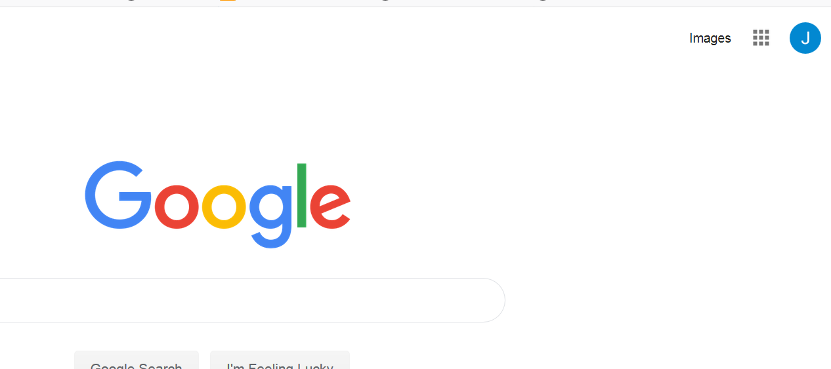
Visit www.google.com Click on Google Apps Select Google Drive

Slide 18
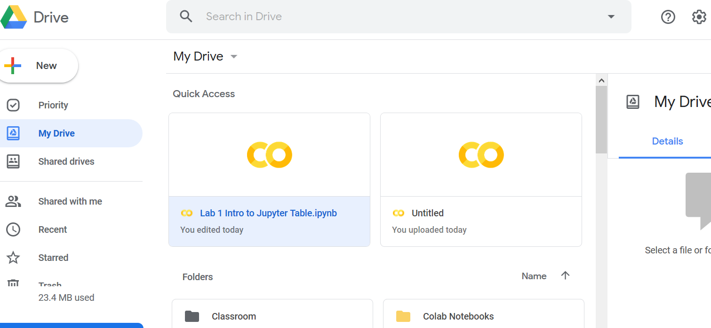
Create a DS 200 data folder in your Google Drive - Click on the My Drive” button, select “New Folder”

Slide 19
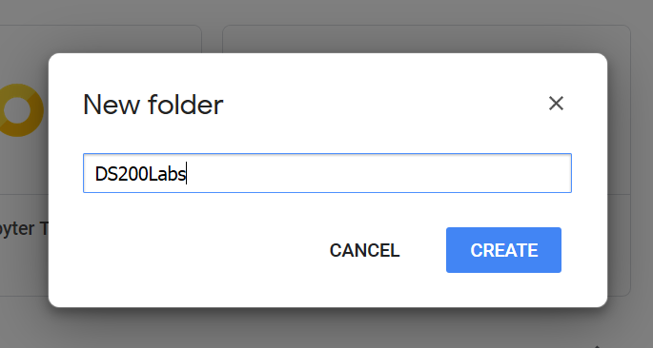
Enter the name of the new folder for storing data used by this course.
The lab instructions (and code) in Jupyter Notebook are based on the assumption that you name the folder as “DS200Labs”.
Note: If you use other name for the folder, you need to replace “DS200Labs” in the Python code (for reading your data file) with the folder name you chose.
Click on the “CREATE” button to create the directory.

Slide 20
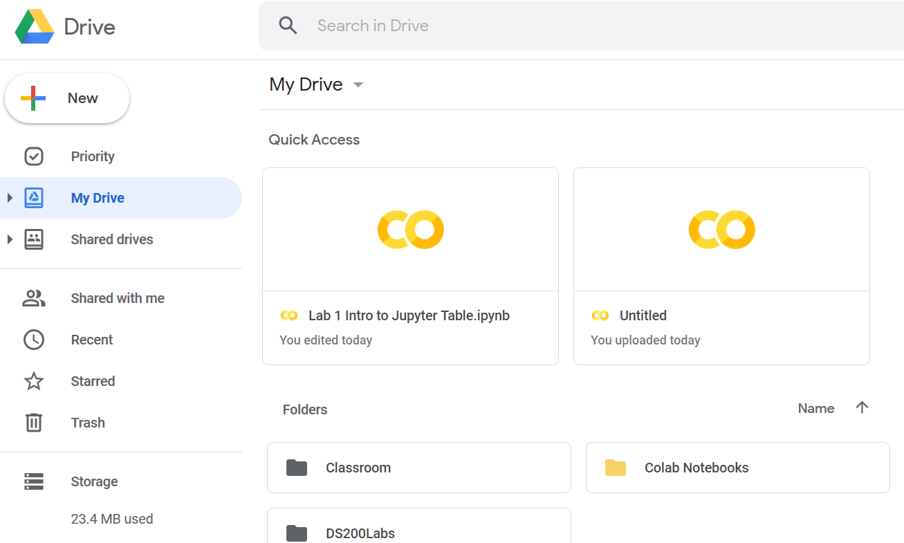
4. Upload data files to the data folder in Google Drive
You should see the data folder you just created in the Google Drive page.
Double click on the folder so that you can upload data into the folder.

Slide 21
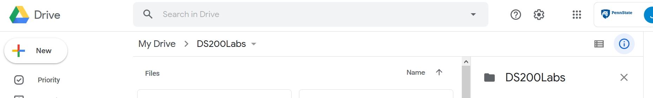
Click on “+ New”, select “File upload”
Find the two data files you saved in slide 3.
SFSalaries2011_2014.csv
IMDB5000movies.csv
Upload each CSV data file to this folder.

Slide 22
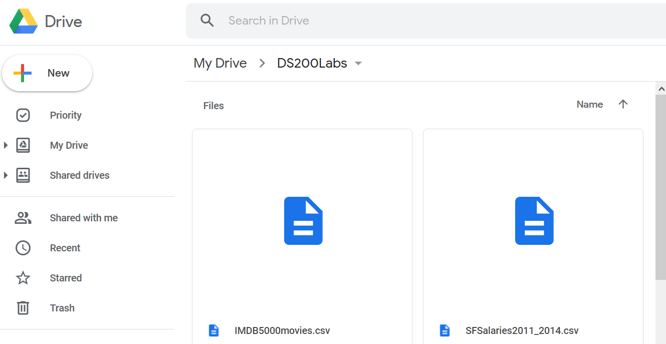
The Two Data Files for Lab 1 Uploaded to your Google Drive

Slide 23
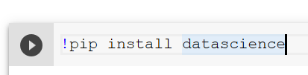
The Lab1 Jupyter Notebook
Read the description about the learning objectives of the lab and why we need to install the datascience module.
Put the cursor on the line with the code !pip install datascience
Click the “>” button (which means to run the python code in the cell).

Slide 24
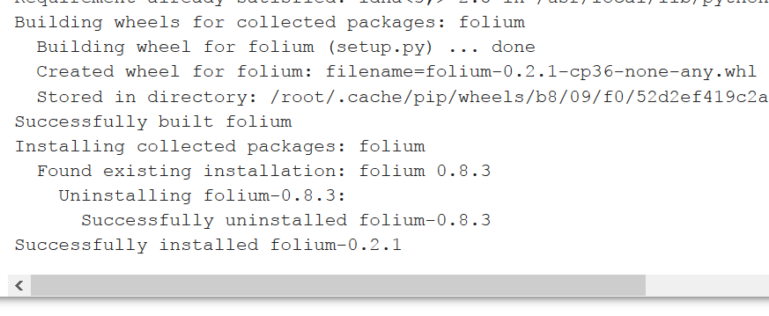
You should see successfully installed message when the installation of the datascience module completes.

Slide 25
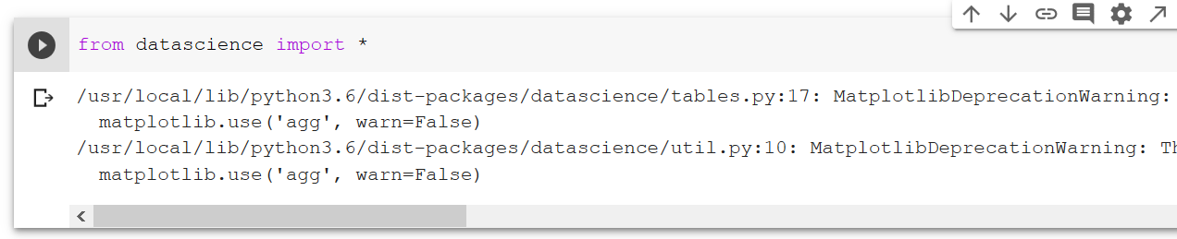

Import datascience module
Run: After you put cursor on the line from datascience import * , click on the Run button
Tip: Wait until a code cell completes BEFORE you execute the next cell.

Slide 26
CONGRATS!
If you successfully import the datascience module, you have reached Milestone 1.
Congratulations!
You can now continue to Part B of the lab

Slide 27
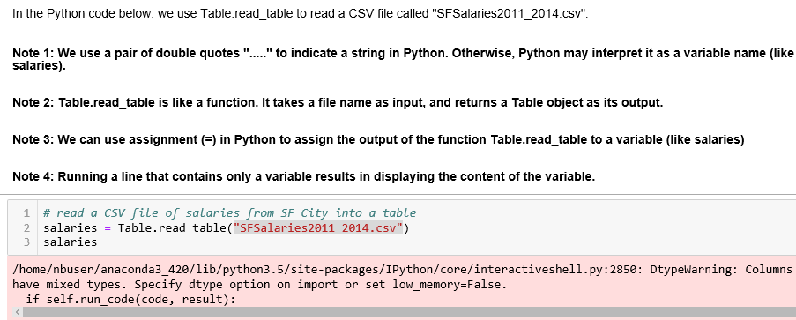
Part B Read a Table
In Part B of the lab, we use a utility (Table class) of datascience module to read a CSV file that contains salary data of employees of San Francisco City.
The Source of Data is Kaggle
https://www.kaggle.com/kaggle/sf-salaries

Slide 28
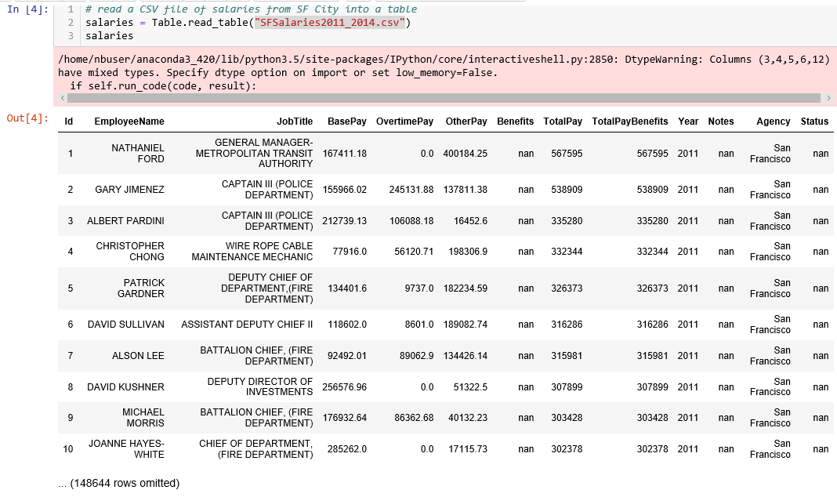

A Quick Way to Show Some Contents of The Table
Names of Columns/Attributes
Total Number of Row is?

Slide 29
Huray!
If you successfully read the salary file into a table and show some of the contents of the table, you have reached Milestone 2.
Huray!
You can now continue to Part C of the lab

Slide 30
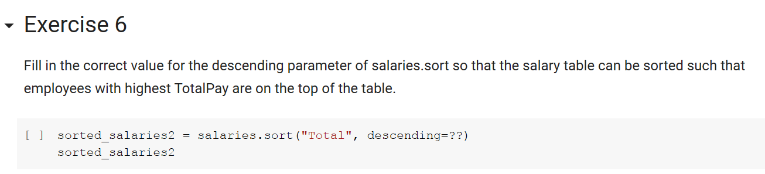
Following instructions on the Jupyter Notebook to complete all 6 Exercises

Slide 31
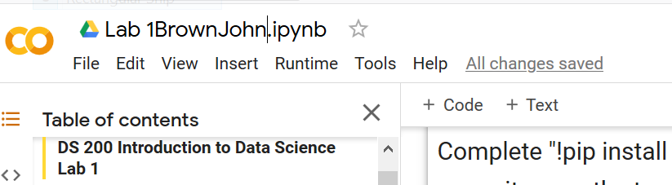
Rename, Save, and Submit Your Notebook
Remember to Save your notebook as you make progress through it.
After you complete Lab 1, rename the file
Click on “File”, select “Rename notebook”
You will see cursor on the name of notebook. You can now edit the notebook’s name to Lab 1<LastName><FirstName>.ipynb
For example, a student named “John Brown” will name the file “Lab 1BrownJohn.ipynb”.
Note: The file extension .ipynb indicates it is a Jupyter Notebook file.

Slide 32
Save Your Notebook OFTEN
Click on File (upper left corner)
Select “Save”
Important: You may loose your modification to a notebook if you do not Save it explicitly.
Advice: Save often.

Slide 33
Download and Submit to Canvas
Click on File
Select “Download .ipynb”
After download is complete
Submit the Notebook file as your submission for Lab 1

Slide 34
What is Jupyter Notebook useful for?
For executing Python code
For storing a data analytic workflow (also known as a “pipeline”) so that it can be reused later
What is this important for Data Scientists?
This helps Data Scientists to achieve “reproducibility” of their data analysis
For modifying an existing data analytic workflow to reduce the effort of executing a workflow similar to a previously executed one.
Why is this important for Data Scientists?
Data Scientists often need to execute similar, but slightly different, workflows multiple times.
Example: Modify a parameter in creating a predictive model on the same data set to see whether the model is improved. ( You will get to do this later in labs and in your project.)

Slide 35
An Exemplar Data Analytic Workflow (Pipeline)
Build a
Predictive Model
Evaluate the
Predictive Model
Build a
Predictive Model
Evaluate the
Predictive Model
Gather
Data
Pre-process
Data
Build a
Predictive Model
Evaluate the
Predictive Model
Select the Best
Predictive Model
Build a
Predictive Model
Evaluate the
Predictive Model
Build a
Predictive Model
Evaluate the
Predictive Model
Model
Gather
Data
Model
Prediction
Analyze
Results
Communicate
Insights or
Recommendations

Slide 36
A Useful Hotkey for Jupyter Notebook
Run selected cell: Ctrl + Enter
Useful for debugging, or for modifying a parameter and see the result immediately.

